Slide 1
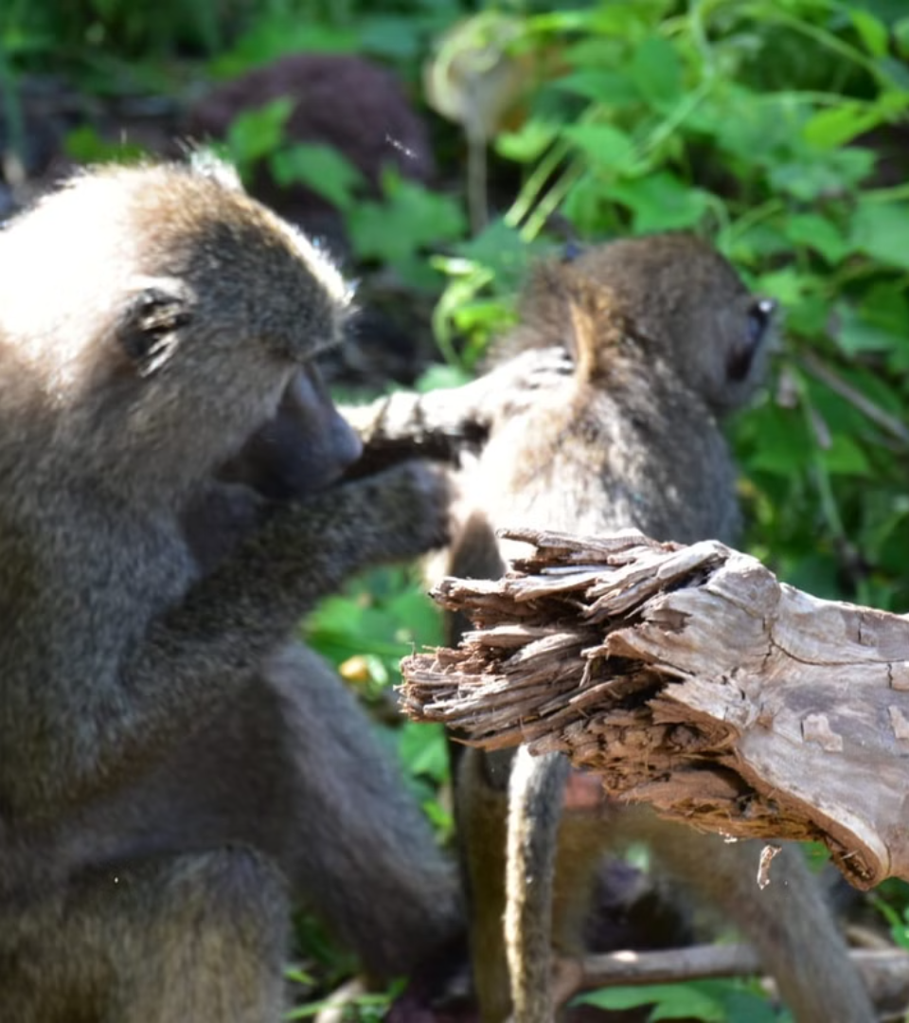
Milestone 2 : Workshop in Computational Analysis of the Microbiome
Tomer Oron & Yuval Dotan

Slide 2
Discussion Points
1
Milestone 1 Recap
2
Proposed Model
3
Validation Results
Review key findings from previous milestone.
Introduce new computational model for microbiome analysis.
Present outcomes from model testing on validation set.

Slide 3


Slide 4
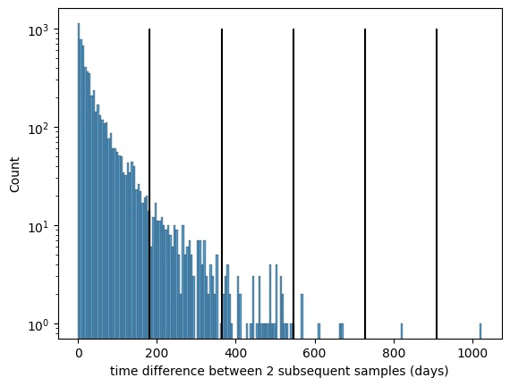
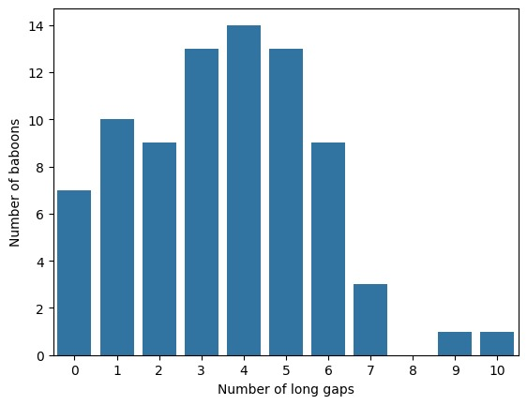
Time Difference Challenge
Average Gap
Long Gaps (Over 180 days)
Gap Frequency
46.849 days between subsequent samples.
affecting 70+ baboons.
Average 3.25 long gaps per baboon.
We can only guess what the baboons have done in these gaps…

Slide 5
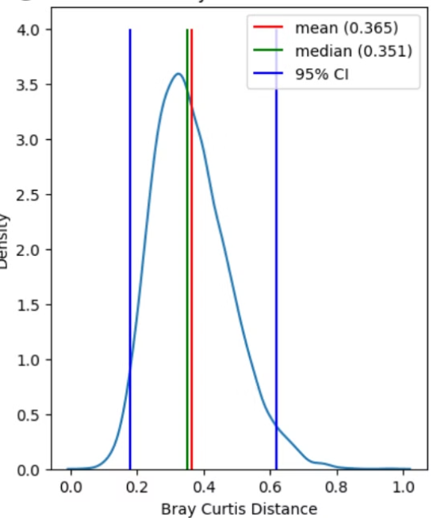
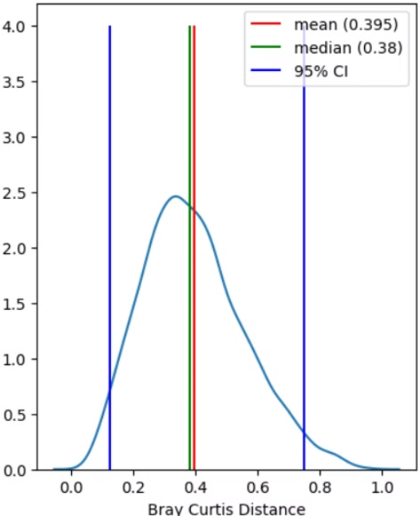
Predictive Power of Previous Samples
Mean of All Previous
Last Sample
Strong predictor for future microbiome composition.
Latest sample highly indicative of current state.

Slide 6
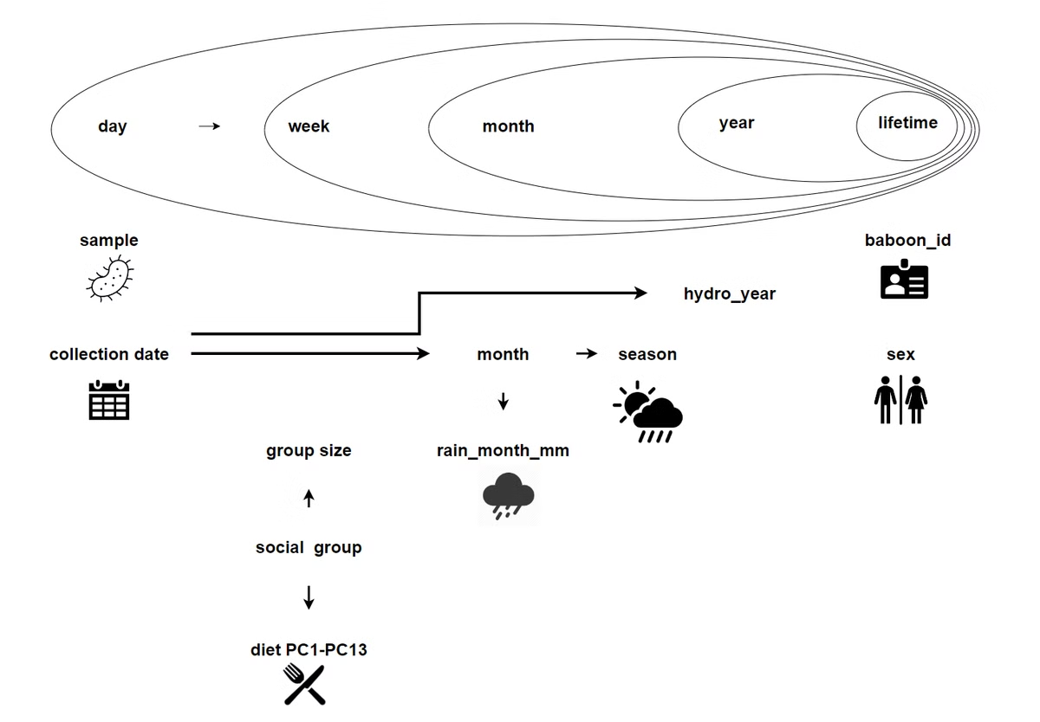
some features are contained in other features

Slide 7

Our Proposed Model

Slide 8

We Want a model that
Using both last sample and the mean of samples
As the time difference between two consecutive samples increases, the influence of the last sample should decrease.
A seasonality effect is present.
$$D_{i}=e^{−λΔt}\cos{\frac{2πΔt}{365} }αD_{i−1}+\left(1−e^{−λΔt}\cos{\frac{2πΔt}{365} }\right)β\overline{\left\{D_{1},…,D_{i−2}\right\}}$$

Slide 9

Data Preprocessing
Baboon Splitting
60 for training, 20 for validation.
Chronological Sorting
Samples arranged by collection date for each baboon.
Same-day Aggregation
Mean calculated for multiple samples on same date from same baboon.

Slide 10
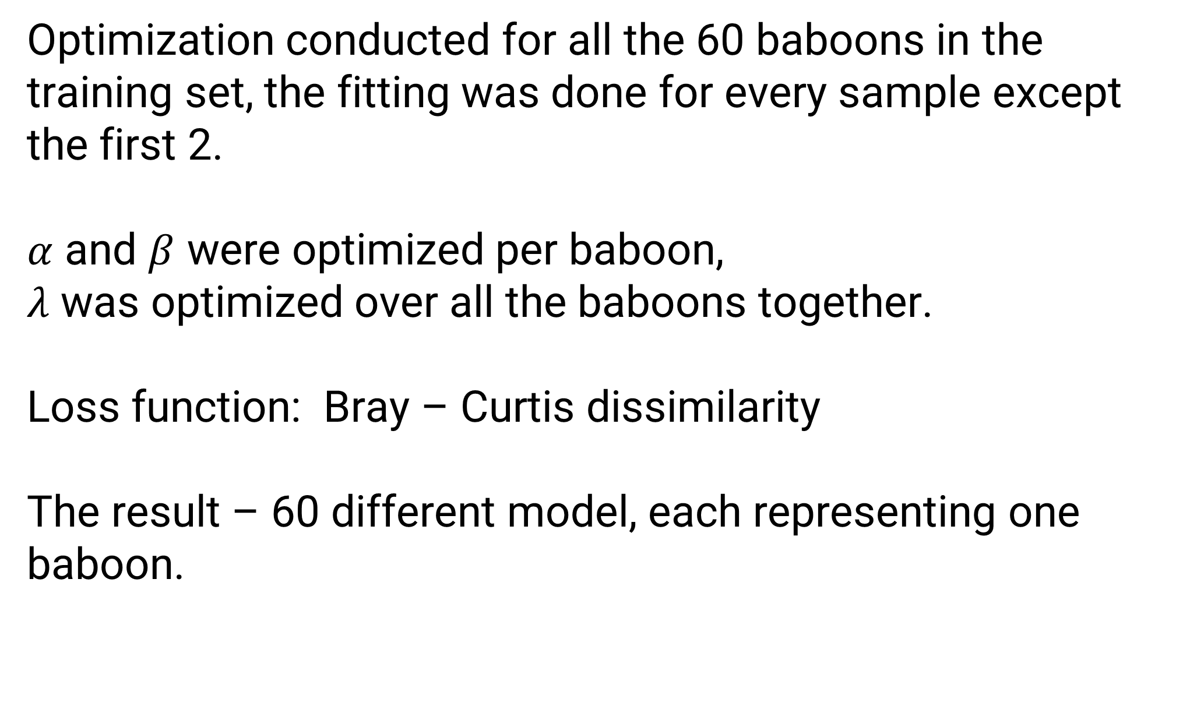
Model Fitting
Optimization conducted for all the 60 baboons in the training set, the fitting was done for every sample except the first 2.
$α$ and $β$ were optimized per baboon,
$λ$ was optimized over all the baboons together.
Loss function: Bray – Curtis dissimilarity
The result – 60 different model, each representing one baboon.

Slide 11
Model Prediction
Given baboon complete metadata, and partial data we would like to predict the missing data
For each sample, using the 60 models trained, we were able to obtain 60 composition prediction
Then the 60 predictions were weighted according to the metadata (specifically the social group) to unite into one prediction

Slide 12
Model validation
For the 20 baboons, we tested 2 scenarios:
1. Tests of predicting the last 10 samples
2. Tests of predicting all samples using only the first 2 samples
Every scenario was tested using iterative, and non iterative prediction

Slide 13
Model validation - Results

